Slide 1
Field Trip Briefing
What to expect

Slide 2
Networking Operating Systems
Linux
Windows Server (2008 or 2012)

Slide 3
Windows Server - Capabilities
IP Address Management (IPAM)
for Discovering, Monitoring, Auditing and Managing Address space on the network
Management and Monitoring for DNS (Domain Name Systems) and DHCP (Dynamic Host Configuration Protocol) servers.
Active Directory
It allows managing like adding, deleting users over the network. It has the capability therefore of authenticating and authorizing users to use a host (or computer) over a network.

Slide 4
Windows Server – Capabilities (Continued)
Virtualization or Hyper-V
Allows you to create a multiple machine within your server, that is, it allows you to create more than one virtual servers for one physical server.
Three Virtual Servers
Physical
Server

Slide 5
Windows Server – Capabilities (Continued)
Supports Multi-Processor Servers
It can support computer servers that has up to 64 processors and maximum of 1 Terabyte of memory. (This depends on what version like in this case it is Windows 2012 Server. Windows Server 2008 R2 for example supports up to 4 processors)

Slide 6
Linux Server - Capabilities
Strong Security
Linux is very strong in security compared to Windows Server because every single file has security level of use. For example user type privileges cannot modify file or processes except their own. However, root user type or the administrator could modify virtually every file or processes.
Virtualization
Some Linux NOS allows now virtualization like Redhat Enterprise Server, CentOS and SUSE

Slide 7
Linux Server - Capabilities
Supports Windows OS Desktop
Could support client’s desktop running on Windows OS using Samba server
Virtualization
Some Linux NOS allows now virtualization like Redhat Enterprise Server, CentOS and SUSE

Slide 8
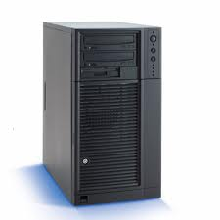
Hardware - Servers
Traditional Servers or Stand Alone servers

Slide 9
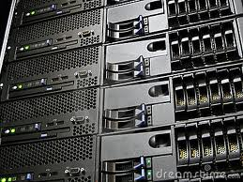
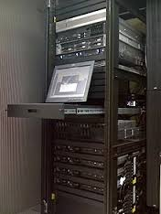
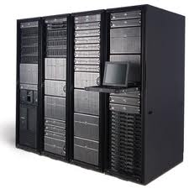
Hardware - Servers
Rack-based Servers

Slide 10
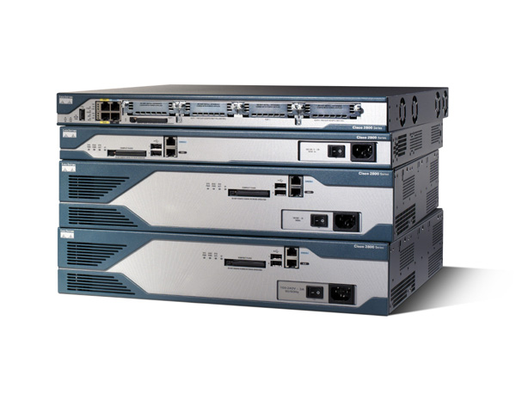
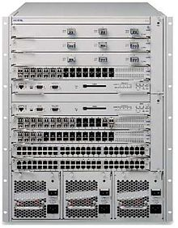
Hardware - Routers
OSI Layer 3 Routers
Non-Cisco Router
Cisco Router
(the No. 1 brand in Routers)

Slide 11
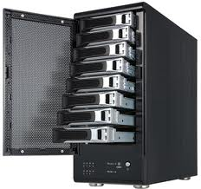
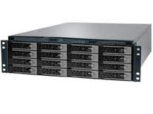
Hardware – Storage
RAID (Redundant Array of Inexpensive Disk)

Slide 12
Hardware – Storage
RAID (Redundant Array of Inexpensive Disk)
Allows you to connect multiple hard drives acting as one single Hard Drive

Slide 13
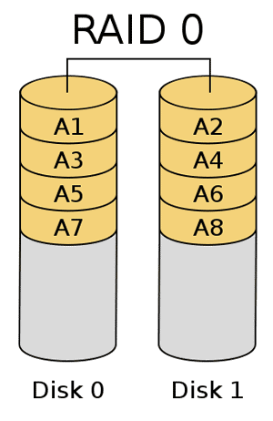
Hardware – Storage
RAID 0 - Striping
Eight (8) Hard Drives acting as one

Slide 14
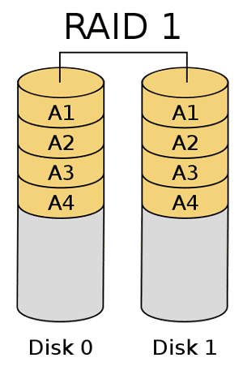
Hardware – Storage
RAID 1 - Mirrored
Four (8) Hard Drives acting as one with
another four Hard Drive as Mirror or
exact copy of the other four hard drives.

